Slide 1
Funny Ads
Harnessing Power of Funny Ads in Marketing

Slide 2



Humour in advertising

Slide 3
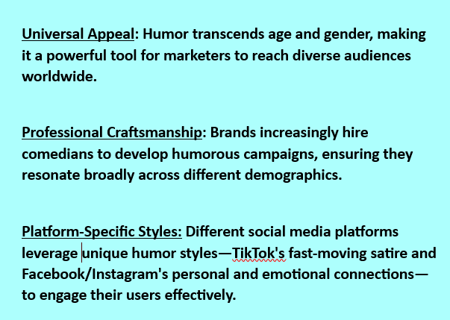

Targeting Humor Properly

Slide 4
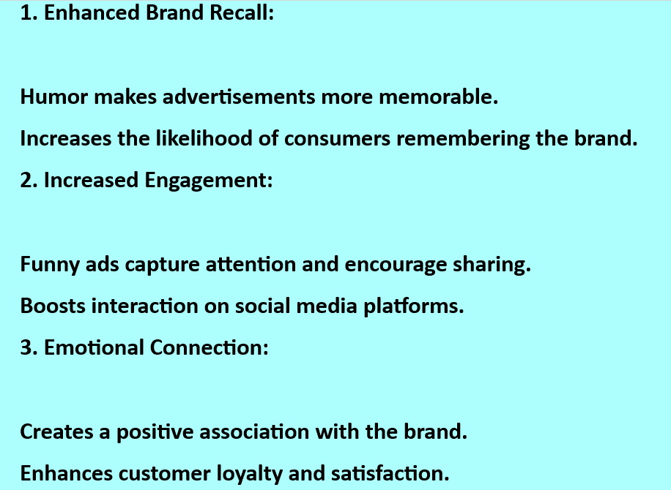
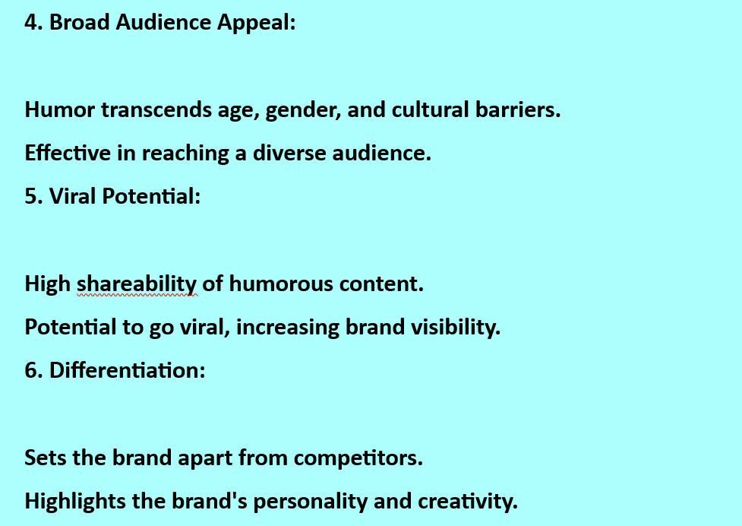
Role of Funny Ads in Marketing

Slide 5
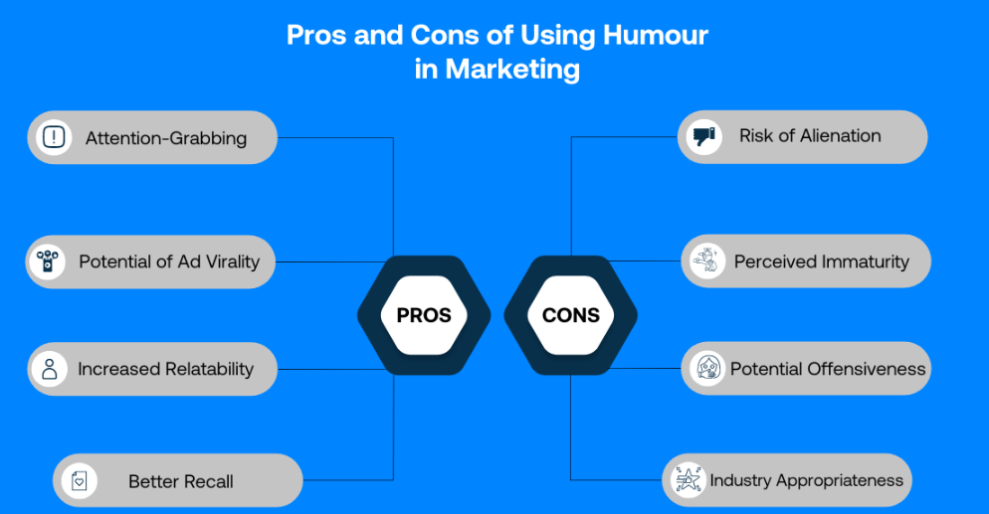
Section Header Layout
Subtitle

Slide 6


Examples of Funny Ads

Slide 7
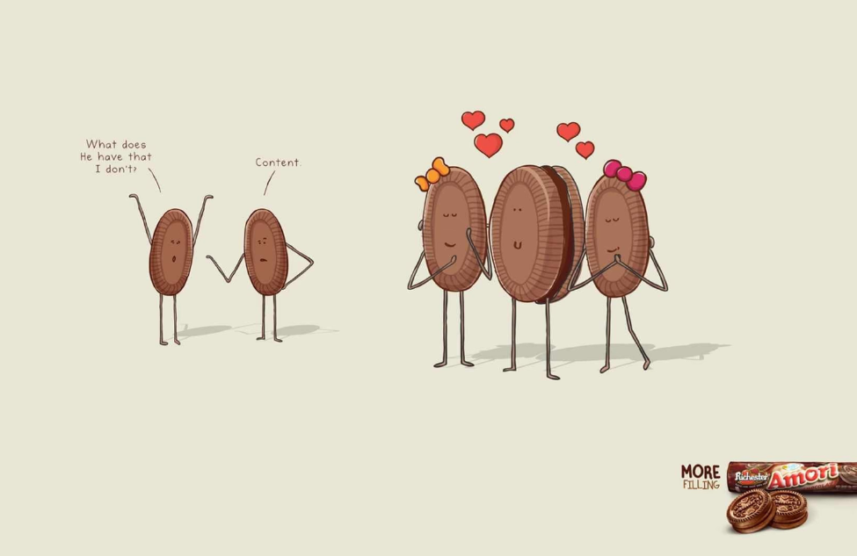

Examples of Funny Ads

Slide 8
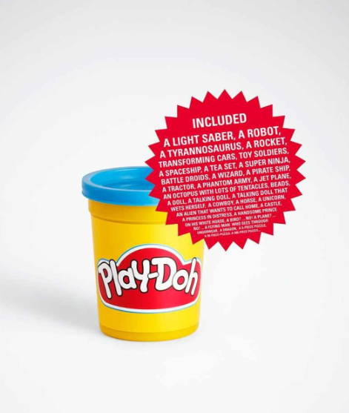
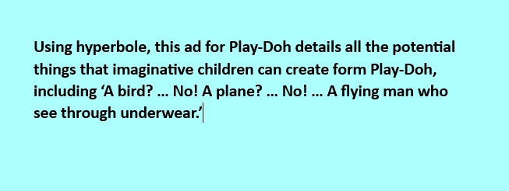
Examples of Funny Ads

Slide 9
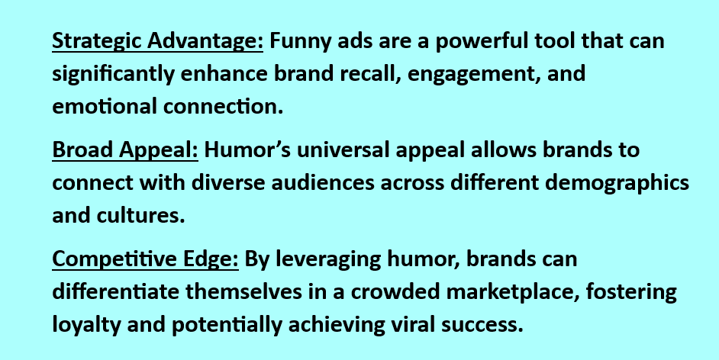
Conclusion

